Slide 1
Software Development and Debug
Zynq
Vivado 2014.2 Version

Slide 2
Objectives
After completing this module, you will be able to:
Describe device drivers architecture
Distinguish between Level-1 and Level-2 device drivers
List types of processor timers
Understand CPU’s private timer API
Describe GNU Debugger (GDB) functionality
Describe Xilinx Microprocessor Debugger (XMD) functionality
Describe Eclipse Target Communications Framework

Slide 3
Outline
Device Drivers Architecture
Timers and API
Debugging Tools
Hardware Tools
Software Tools
Debug in SDK
Summary

Slide 4
Device Drivers
The Xilinx device drivers are designed to meet the following objectives:
Provide maximum portability
The device drivers are provided as ANSI C source code
Support FPGA configurability
Supports multiple instances of the device without code duplication for each instance, while at the same time managing unique characteristics on a per-instance basis
Support simple and complex use cases
A layered device driver architecture provides both
Simple device drivers with minimal memory footprints
Full-featured device drivers with larger memory footprints
Ease of use and maintenance
Xilinx uses coding standards and provides well-documented source code for developers
Notes:
The Xilinx device drivers are designed to meet the following goals and objectives.
Provide maximum portability: The device drivers are provided as ANSI C source code. ANSI C was chosen to maximize portability across processors and development tools. Source code is provided both to aid designers in debugging their applications as well as modifying or optimizing the device driver if necessary. A layered device-driver architecture additionally separates device communication from processor and Real Time Operating System (RTOS) dependencies. This provides portability of core device driver functionality across processors and operating systems.
Support FPGA configurability: Because FPGA-based devices can be parameterized to provide varying functionality, the device drivers must support this varying functionality. The configurability of device drivers should be supported at compile time and at run time. Run-time configurability provides the flexibility required for future dynamic system reconfiguration. In addition, a device driver supports multiple instances of the device without code duplication for each instance, while at the same time managing unique characteristics on a per-instance basis.
Support simple and complex use cases: Device drivers are required for simple tasks, such as board bring-up and testing, as well as complex embedded system applications. A layered device driver architecture provides both simple device drivers with minimal memory footprints and more robust, full-featured device drivers with larger memory footprints.
Ease of use and maintenance: Xilinx makes use of coding standards and provides well-documented source code to give developers (for example, customers and internal development) a consistent view of source code that is easy to understand and maintain. In addition, the API for all device drivers is consistent to provide a similar look and feel between drivers.

Slide 5
Drivers: Level 0/Level 1
The layered architecture provides seamless integration with…
(Level 2) RTOS application layer
(Level 1) High-level device drivers that are full-featured and portable across operating systems and processors
(Level 0) Low-level drivers for simple use cases
Level 2, RTOS Adaptation
Level 1, High-level Drivers
Level 0, Low-level Drivers
Notes:
The layered architecture accommodates the many use cases of device drivers, while providing portability across operating systems, toolsets, and processors. The layered architecture also provides seamless integration with an RTOS (Layer 2), with high-level device drivers that are full-featured and portable across operating systems and processors (Layer 1) and with low-level drivers for simple use cases (Layer 0). You can choose to use any and all layers.

Slide 6
Drivers: Level 0
Consists of low-level device drivers
Implemented as macros and functions that are designed to allow a developer to create a small system
Characteristics:
Small memory footprint
Little to no error checking is performed
Supports primary device features only
No support of device configuration parameters
Supports multiple instances of a device with base address input to the API
Polled I/O only
Blocking function calls

Slide 7
Drivers: Level 1
Consists of high-level device drivers
Implemented as macros and functions and designed to allow a developer to utilize all of the features of a device
Characteristics:
Abstract API that isolates the API from hardware device changes
Supports device configuration parameters
Supports multiple instances of a device
Polled and interrupt driven I/O
Non-blocking function calls to aid complex applications
May have a large memory footprint
Typically, provides buffer interfaces for data transfers as opposed to byte interfaces

Slide 8
Comparison Example
UARTPS Level 1
XUartPs_CfgInitialize() - Initializes a specific XUartPs instance such that it is ready to be used
XUartPs_Send() - Sends the specified buffer using the device in either polled or interrupt driven mode.
XUartPs_Recv() - Receive a specified number of bytes of data from the device and store it into the specified buffer.
XUartPs_SetBaudRate() - Sets the baud rate for the device.
UARTPS Level 0
XUartPs_SendByte()- Sends one byte using the device.
XUartPs_RecvByte()- Receives a byte from the device.

Slide 9
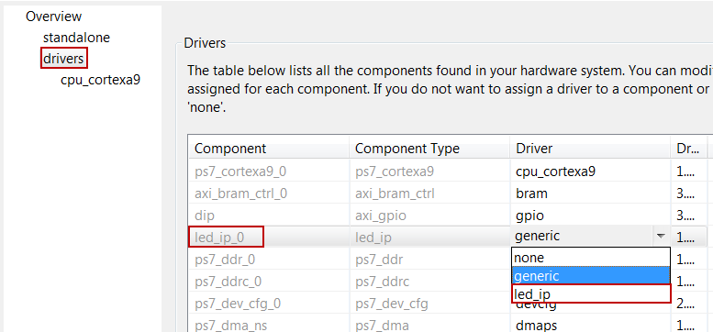
Driver Settings
Select the Drivers panel
By default, the Driver panel displays which device driver is used for each hardware instance in the design
Enables selection of custom drivers and versions for each device in the design

Slide 10
Outline
Device Drivers Architecture
Timers and API
Debugging Tools
Hardware Tools
Software Tools
Debug in SDK
Summary

Slide 11
Timers: Cortex-A9 Processor
Timers are an important part of an embedded system
CPU Private Timer and Watchdog Timer
Global timer (GTC)
Two 16-bit triple timer counter (TTC)
System watchdog timer (SWDT)

Slide 12
Private Timer/Counter (Standalone)
By default 32-bit count down timer
xscutimer.h, xscutimer_hw.h header files
XScuTimer_LookupConfig() - Looks up the device configuration based on the unique device ID
XScuTimer_CfgInitialize() - Initialize a specific XTtcPs instance such that the driver is ready to use
XScuTimer_Start() – Start the timer
XScuTimer_Stop() – Stop the timer
XScuTimer_GetPrescaler() – Get the pre-scalar value
XscuTimer_SetPrescaler() – Set the pre-scalar value between 1 and 16

Slide 13
Private Timer/Counter (Standalone)
XScuTimer_EnableAutoReload() – Load the counter with the initial value when time out occurs
XScuTimer_IsExpired() – Check if the timer has reached the final value
XScuTimer_RestartTimer() – Read the counter value and write it back
XScuTimer_LoadTimer() – Load the timer with the provided value
XScuTimer_GetCounterValue() – Get current counter value; useful for determining lapse time
XScuTimer_EnableInterrupt() – Enable interrupt mechanism
XScuTimer_GetInterruptStatus() – Get the interrupt status
XScuTimer_ClearInterruptStatus() – Clear source of interrupt flag

Slide 14
Timers: Triple Timer Counter API (Standalone)
XTtcPs_LookupConfig() - Looks up the device configuration based on the unique device ID
XTtcPs_CfgInitialize() - Initialize a specific XTtcPs instance such that the driver is ready to use
XTtcPs_SetMatchValue() - Set the value of the match registers
XTtcPs_SetOptions() - Set the options for the TTC device
XTtcPs_SetPreScalar() - Set the prescalar enable bit
XTtcPs_GetMatchValue() - Get the value of the match registers
XTtcPs_GetOptions() - Gets the settings for the options for the TTC device
XTtcPs_GetPrescaler() - Gets the input clock prescalar

Slide 15
AXI Timer
XTmrCtr_Initialize() - Initialize a specific timer/counter instance/driver
XTmrCtr_InterruptHandler() - Interrupt Service Routine (ISR) for the driver
XTmrCtr_SetHandler() - Sets the timer callback function, which the driver calls when the specified timer times out
XTmrCtr_GetOptions() - Enables the specified options for the specified timer counter
XTmrCtr_Start() - Starts the specified timer counter of the device such that it starts running
XTmrCtr_Stop() - Stops the timer counter by disabling it
XTmrCtr_GetCaptureValue() - Returns the timer counter value that was captured the last time the external capture input was asserted

Slide 16
AXI Timer
XTmrCtr_GetOptions() - Get the options for the specified timer counter
XTmrCtr_GetStats() - Get a copy of the XtmrCtrStats structure, which contains the current statistics for this driver
XTmrCtr_Getvalue() - Get the current value for the timer counter
XTmrCtr_Reset() - Reset the specified timer counter of the device

Slide 17
Outline
Device Drivers Architecture
Timers and API
Debugging Tools
Hardware Tools
Software Tools
Debug in SDK
Summary

Slide 18
Debugging
Debugging is an integral part of embedded systems development
The debugging process is defined as testing, stabilizing, localizing, and correcting errors
Two methods of debugging:
Hardware debugging via a logic probe, logic analyzer, in-circuit emulator, or background debugger
Software debugging via a debugging instrument
A software debugging instrument is source code that is added to the program for the purpose of debugging
Debugging types:
Functional debugging
Performance debugging

Slide 19
Software Debugging Support
Vivado/SDK supports software debugging through
GDB tools
Unified graphical interface for debugging and verifying processing systems
Xilinx Microprocessor Debugger (XMD)
Runs all the hardware debugging tools and communicates with the hardware
Shell for hardware communication
Tool command language (Tcl) syntax and command interpreter
GNU tools communicate with the hardware through XMD
Xilinx System Debugger, Eclipse Target Communications Framework (TCF)
Notes:
GDB is a powerful yet flexible tool that provides a unified interface for debugging and verifying MicroBlaze and PowerPC systems during various development phases.

Slide 20
Hardware Debugging Support
Vivado supports hardware debugging via the following tools
Vivado Logic Analyzer software
Soft-core base logic analyzer
Operates through a Xilinx download cable
Zynq™ AP SoC virtual platform
Functional simulation of physical hardware for the purpose of software development, integration, and test
Runs on the desktop
Facilitates early software development and test
Zynq AP SoC open-source QEMU model
Open-source machine emulator and virtualizer for Linux environment

Slide 21
XMD Debugger
The Xilinx Microprocessor Debug (XMD) utility provides a variety of user debug services
Physical connection between your workstation and the software design
Connection to an internal BSCAN controller
Program download
Processor identification and control
Low-level debug commands
Interface to the GNU debugger
General Tcl interface and command interpreter
Program download

Slide 22
XMD Debugger
For debugging standalone or bare-metal applications, serves as gdbserver for gdb and SDK
For Linux applications, SDK interacts with a gdbserver running on the target
XMD is started via the Xilinx Tools > Program FPGA command in SDK
XMD is essentially launched and controlled via the RUN menu

Slide 23
XMD Functionality
XMD engine
Program that facilitates a unified GDB interface
Tcl interface and command interpreter
XMD supports application debugging on different targets
GDB/TCF can connect to XMD on the same computer or on a remote computer on the Internet

Slide 24
XMD Commands
There are many XMD commands
Popular commands for boot and program control
connect – connect to processor
dow – download ELF executable file
elf_verify – verify ELF file with memory image
run – begin program execution from reset
con – continue program execution from current program counter
stop – stop the target processor
exit – close XMD window
XMD will search for a processor when started and launched from the SDK Run > Debug menu
connect command will execute automatically
connect arm 64

Slide 25
XMD Tcl Inteface
xhelp: Lists all Tcl commands
xrmem target addr [num]: Reads num bytes or 1 byte from the memory addr
xwmem target addr value: Writes an 8-bit byte value at the specified memory addr
xrreg target [reg]: Reads all registers or only register number reg
xwreg target reg value: Writes a 32-bit value into register number reg
xdownload target [-data] filename [addr]: Downloads the given ELF or data file (with -data option) onto the memory of the current target
xcontinue target [addr]: Continues execution from the current PC or from the optional address argument

Slide 26
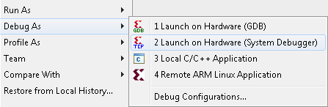
System Debugger
Eclipse Target Communication Framework
Extensible network protocol for communicating with embedded systems
Single Configuration per target
(Not per tool like gdb)
Homogenous, and heterogeneous, SMP and AMP support
Neon Support
True multicore debug through a single JTAG
Faster than GDB/XMD

Slide 27
Eclipse Target Communication Framework
Separate connections
Open, extensible network protocol
Allows services to transparently plug in
All communication links can share the same protocol
Transport-agnostic channel abstraction
(No specific transport layer. E.g. TCP/IP, Serial Line, SSH tunnel)
ARM1
Debug1
Debug2
ARM2
ChipScope
Separate connections
ARM1
Debug1
TCF
Debug2
ARM2
ChipScope

Slide 28
Debug Functionality
Source-level debugger (GDB/System Debugger)
Start your program
Set breakpoints (make your program stop on specified conditions)
Examine what has happened, when your program encounters breakpoints
Registers
Memory
Stack
Variables
Expressions
Change things in your program so that you can experiment with correcting the effects of one bug and go on to another
You can debug programs written in C and C++

Slide 29
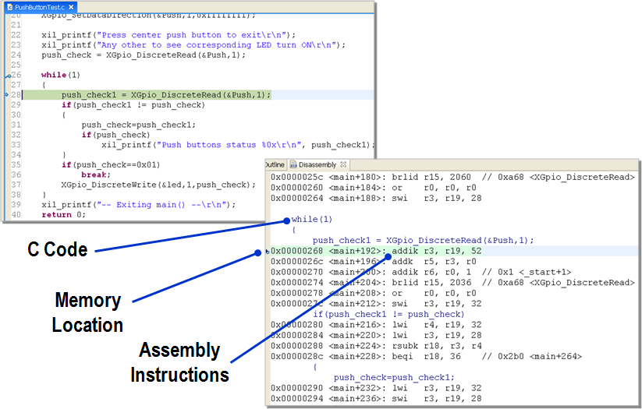
Debug

Slide 30
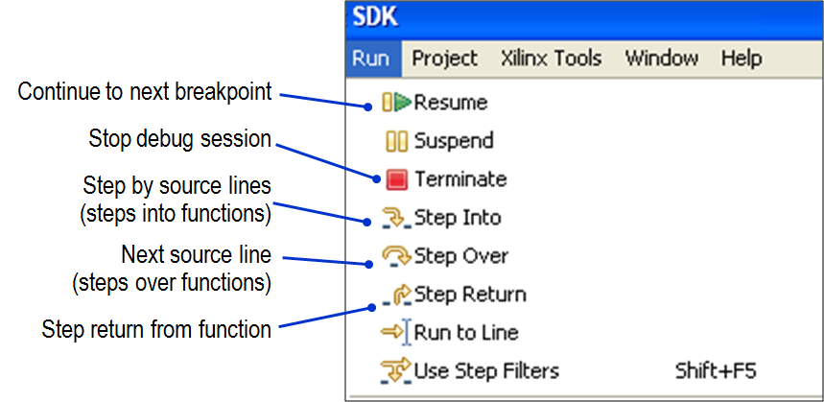
Debug GUI
Run-time control

Slide 31
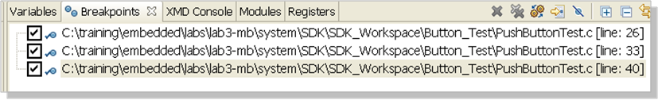
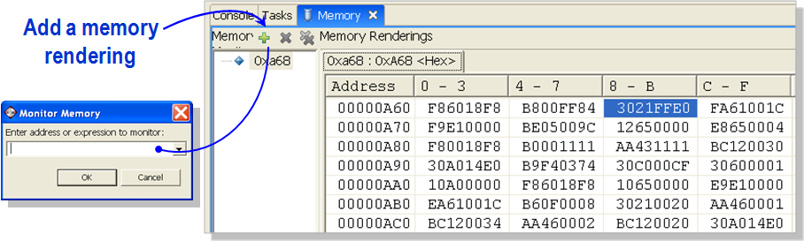
Debug Functionality
Breakpoints can be enabled or disabled
To change any memory value, click a memory field

Slide 32
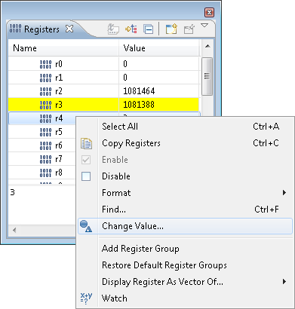
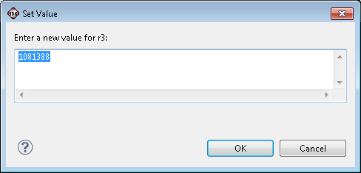
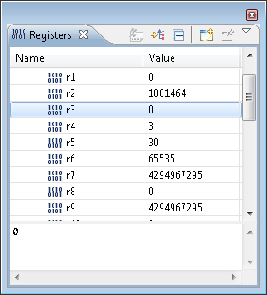
Debug Functionality
Yellow represents registers that have changed (useful when following assembly code)
To change any value, click to edit, or right-click the field

Slide 33
Outline
Device Drivers Architecture
Timers and API
Debugging Tools
Hardware Tools
Software Tools
Debug in SDK
Summary

Slide 34
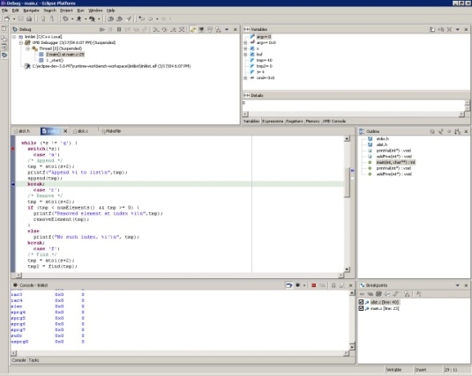
Debugging Using SDK (XMD)
Eclipse
Auto-Launched
mb-gdb (host software)
Debugging Remote Protocol
Xilinx Custom Graphical Debug Interface
XMD
Auto-Launched
JTAG/XMD Protocol
Notes:
SDK debugging using GDB/XMD:
Seamless debugging in the Debug Perspective
Built-in XMD and GDB launchers
Integrated XMD console, direct access for non-GDB supported XMD features

Slide 35
Debugging Using SDK (TCF)
Eclipse
Auto-Launched
System Debugger
Debugging Remote Protocol
Xilinx Custom Graphical Debug Interface
TCF
Auto-Launched
JTAG Protocol

Slide 36
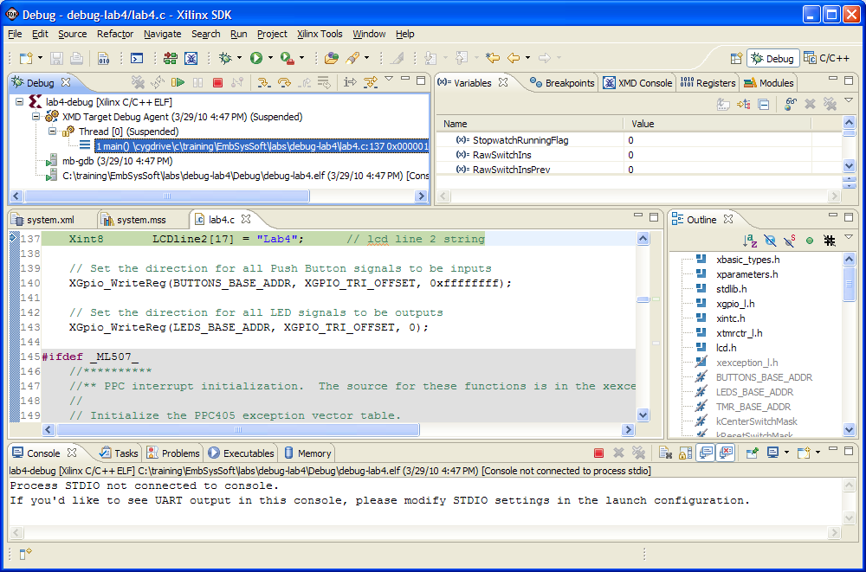
SDK Debug Perspective
1
Stack frame
for target threads
Variables, breakpoints,
and registers views
C/C++ editor
Code outline and disassembly view
Console view
2
1
2
3
4
3
4
5
5
Notes:
Stack frame for target threads that you are debugging. Each thread in your program is represented as a node in the tree.
Variables, breakpoints, and registers views allow for viewing and real-time interaction with the displayed contents.
The C/C++ editor highlights the location of the execution pointer and allows you to set breakpoints.
The Code Outline and Disassembly view provide compiler-level insight to what is occurring in the running source.
The Console view lists output information.

Slide 37
Outline
Device Drivers Architecture
Timers and API
Debugging Tools
Hardware Tools
Software Tools
Debug in SDK
Summary

Slide 38
Summary
Debugging is an integral part of embedded systems development
Vivado provides tools to facilitate hardware and software debugging
Hardware debugging is done through using Vivado Logic Analyzer
Software debugging is performed using xmd and GNU debugger
SDK provides environment, perspective, and underlying tools to enable seamless software debugging
XMD/GDB Debug
Single service on dedicated connection
System Debugger/TCF
Multicore Debug, shared connection

